Slide 1

G2M Case Study
Company Name
Date
Tahsin Azad
Virtual Internship
2025

Slide 2
Content overview
Problem
Areas of Interest
Hypotheses
Exploratory Data Analysis
Conclusions
Thank you

Slide 3
The aim of this presentation is to give recommendations and advice to XYZ on investments in the cab industry.
Problem

Slide 4
Areas of interest after looking at data are:
- City
- Gender
- Income
- Age
- Company
Areas of Interest

Slide 5
Some questions thought about:
Is there a benefit for an investor to choose one company over the other?
Is there a city an investor should prioritize due to income?
Is there a city an investor should prioritize due to usage?
Which gender should be targeted the most through advertisements?
Are the prices per km consistent? Which cities have the most expensive?
Hypotheses

Slide 6
Exploratory Data Analysis

Slide 7
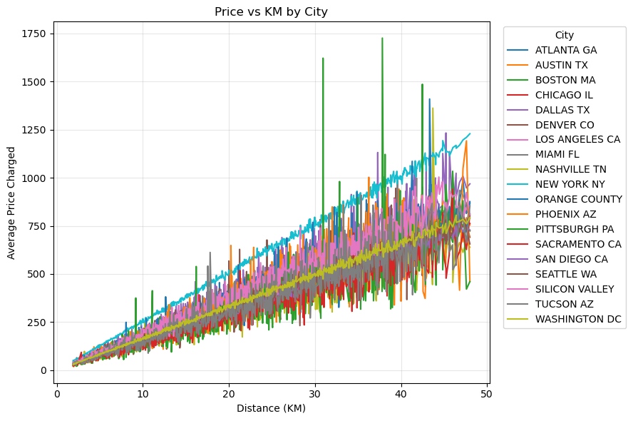
Are the prices per km consistent? Which cities have the most expensive?
Answer:
Boston has many outliers. XYZ should avoid it due to the outliers and inconsistencies
New York still charges more per KM, but it is consistent

Slide 8
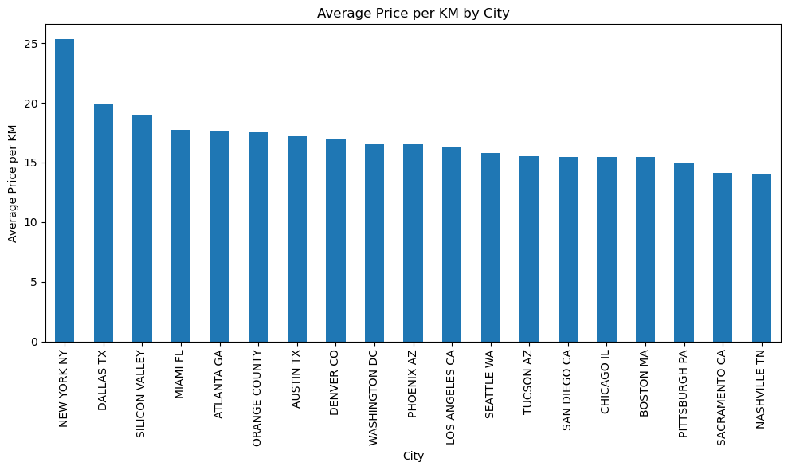
Again, a better graph above showing New York charging the most, while the rest are seemingly the same
XYZ should focus on New York, Los Angeles, Chicago, and Washington DC

Slide 9
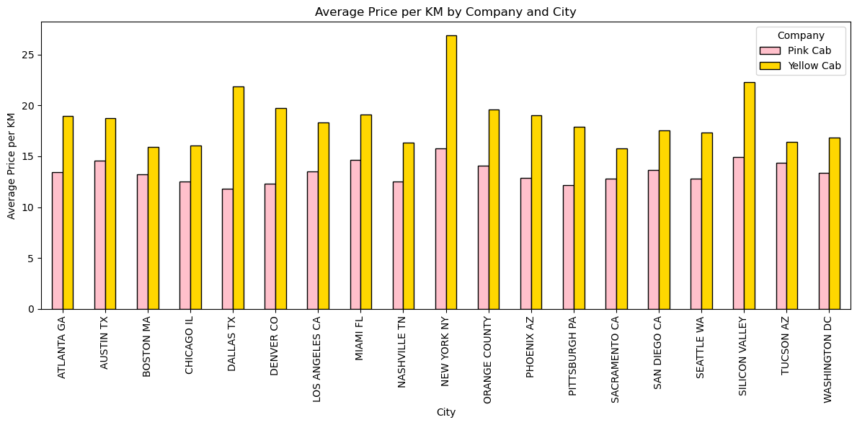
Which company has more transactions?
Answer:
Yellow cab has more sales and charges more by km than Pink cab
XYZ should definitely invest in Yellow cab more. The only case where it fails is if the public decide to user Pink cab- however it seems that Yellow cab simply is either more famous or has better quality

Slide 10
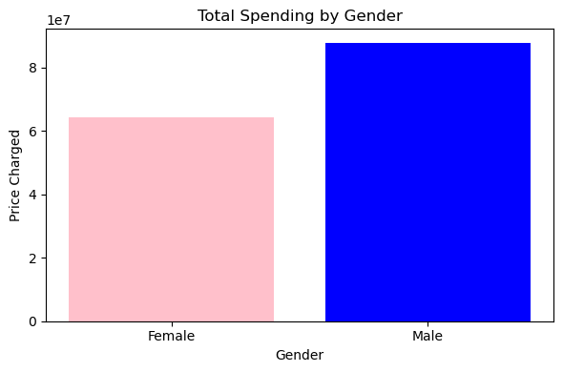
Which gender should be targeted the most through advertisements?
Answer:
With the data given, it has more males so it is expected the graph would show more male spending
With lack of complete data, It does not seem like XYZ should focus on just one gender

Slide 11
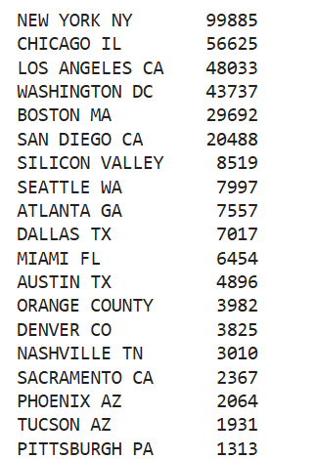
Is there a city an investor should prioritize due to usage?
Answer:
We found that the first five cities, New York, Chicago, Los Angeles, Washington, and Boston seem to have the most usage. Therefore, if investors need to choose a city, these would be great options
Furthermore, cities like Phoenix, Tucson, and Pittsburg should be avoided.

Slide 12
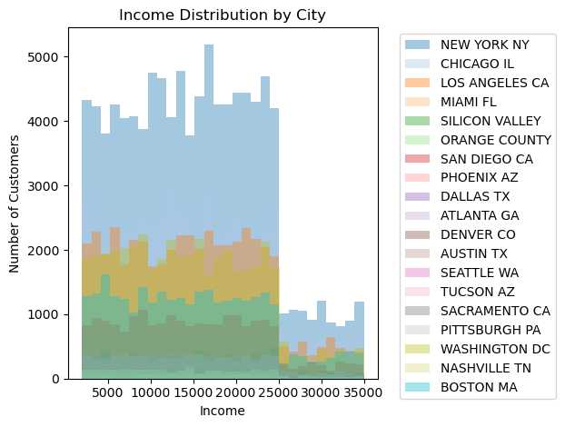
Is there a city an investor should prioritize due to income?
Answer:
As expected, many outliers, so average income does not matter.
However, highest regular income seems to be New York and Los Angeles and San Diego

Slide 13
To conclude, this is what we recommend for XYZ:
- Invest in Yellow cab company, keeping in mind that social media and advertisement may change sentiment towards Pink cab
- Invest in New York the most, followed by Los Angeles, San Diego, Chicago, and Washington DC. These are the best cities for both cab companies
- If after investments, XYZ wishes to do advertisements to support their investments, it should happen in these cities
Conclusion

Slide 14
Thank you

